Slide 1
Introduction to Python

Slide 2



Objectives
Appreciate the larger phenomenon of Open Source Software (OSS)
Understand the basics of programing languages
Programing concepts : In three lessons
Notes:
Results of first essay is close to complete

Slide 3

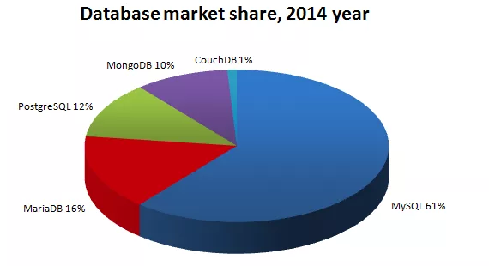
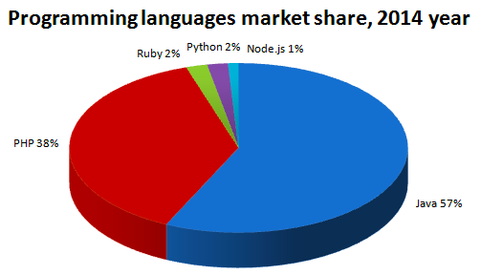
Open Source Software
Free and open source software
Source code is made available to everyone
Free as in freedom
A brief history
1960 to 1980: Academic setting with high autonomy
UNIX at Bell Labs
1980 to 1990s:Formalization of OSS
UNIX commercialised by AT&T
Richard Stallman creates FSF and GNU licence
Eric Raymond creates OSI
Post 1990: Organizations embrace OSS
2001 IBM opens its 40$mn software – eclipse software foundation
2016 Google has started over 900 OSS projects
Best Examples – Linux, Apache, Python
MongoDB 10%
CouchDB1%
SQL 12%
Maria DB 16%
MySQL 61%%
RUBY 2%
PYTHON 2%
PHP 38%
JAVA 57%
Notes:
Platforms

Slide 4
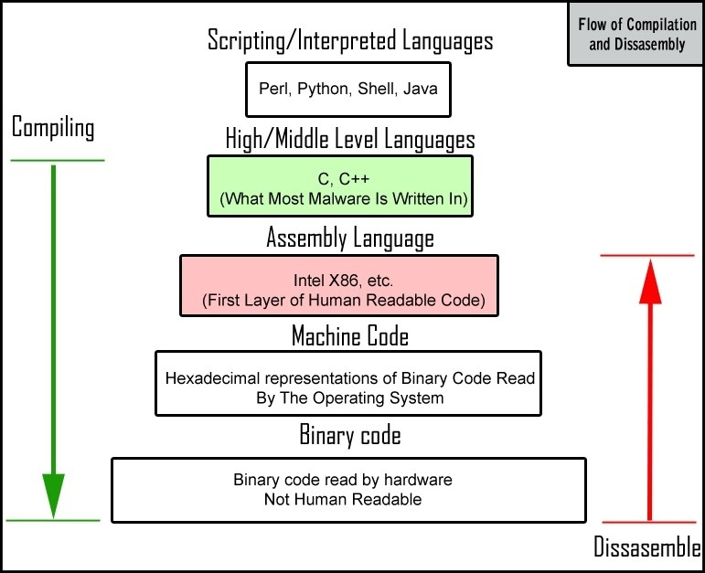
Programming Language
Alan Turing and computing
Formalizing the concept of algorithm and computation with the Turing Machine
Stored program computer – treat algorithms as data
Programming language
Is how we communicate with machines
From GUI to Machine level language
Syntax
A set of rules that define how the programming language is written
Grammar of programming language
Notes:
Platforms

Slide 5
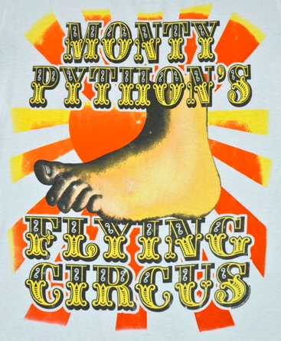
Python
Simplicity
High level language built on C
Benefits of being high level and at the same time provides for CPU-efficient code
Usability
Lots of documentation
Active development community to answer questions - stackexchange
Extensibility
Small core language with a large standard library and an easily extensible interpreter
Leverage OSS community by allowing for extensibility
Big data management using Python
CERN and Large Hadron Collider
Particle detector (Atlas)
Data equivalent to 100 Megapixel camera taking 40 million pictures a second
Needle in a haystack – couple quadrillion collisions to find 1000 collisions that results in Higgs Boson
Pre-process this stunning amount of data in real time and store only the relevant for further analysis
Notes:
Platforms

Slide 6
Object oriented programming
Object Oriented Programing language
Objects rather than actions and data rather than logic
What we really care about are the objects we want to manipulate rather than the logic required to manipulate them
Step 1: Identify all the objects that the programmer wants to modify (data modeling)
Step 2: Generalize groups of similar objects as classes (class is blueprint for an object)
Step 3: Define the logic (methods) that works within the classes
When you code do you think of the function or the data structures first ? OOP vs. procedural
Encapsulation, Inheritance
Parent Class -> Mammal
Field -> Sex
Field -> Age
Method -> Eat
Method -> Sleep
Child Class -> Human being
Field-> Name
Inherited field -> Sex
Inherited field -> Age
Method -> Update age, if age = 100, stop
Method -> Write code
Inherited method -> Eat
Inherited method -> Sleep
Object/Instance of class human being -> Poonacha
Name -> Poonacha
Sex -> M
Age -> 32
If you want me to eat a chocolate, you provide the following command: poonacha.eat(chocolate)
Notes:
Encapsulation ( private fields can be read and written by the methods of the same class)
Inheritance (Inherit the fields and methods of of a class that you inherit) Eg. Class Human Beings (Child class) inherits from Class Mammals (Parent class)
Learn more about OOP - https://www.youtube.com/watch?v=lbXsrHGhBAU&t=1295s

Slide 7
Integrated Development environment
Anaconda with Spyder and Ipython
Anaconda is a distribution of python using a permissive license – BSD
Spyder is an open source, integrated development environment (IDE)
Ipython is an output consol
I[python notebook (Jupyter): Tool to create documents with code, text and charts
Inline mode helps you display plots and graphics
Ipython notebook is a great way to store chunks of code along with comments and results
Python 2 vs. 3
Incompatible hardfixes
Support for unicode characters – very helpful when dealing with twitter data !

Slide 9
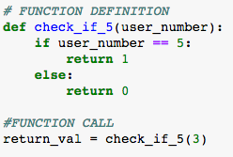
Parameters passed into the function by the function call
User defined function name
Parentheses and colon part of the syntax
Define Keyword
Indention to identify what belongs within the function

